Slide 1


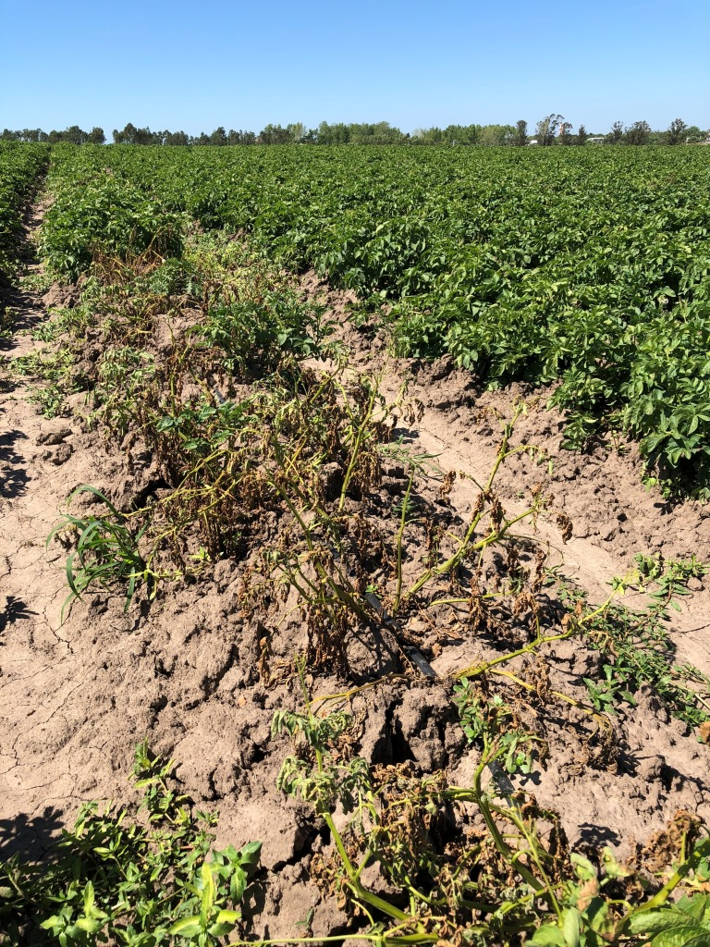
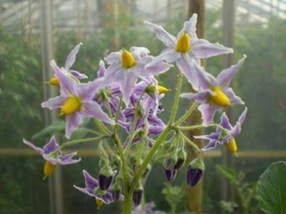
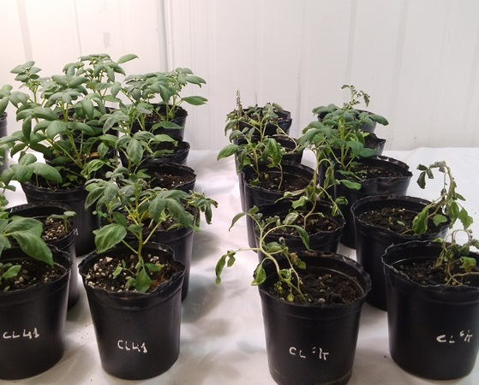
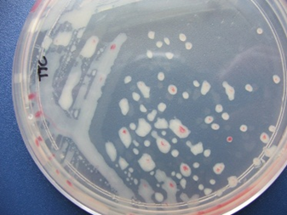
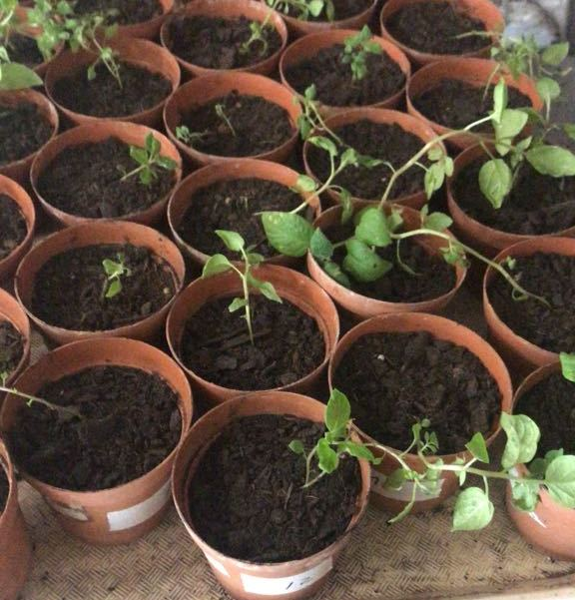
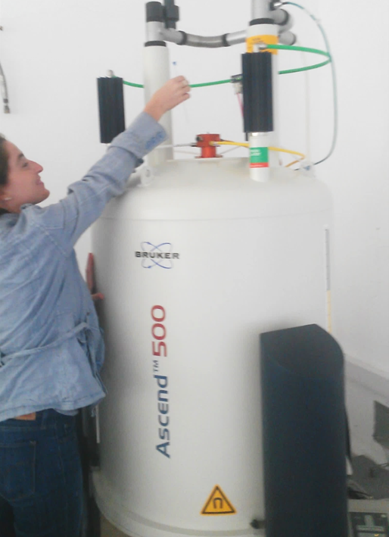
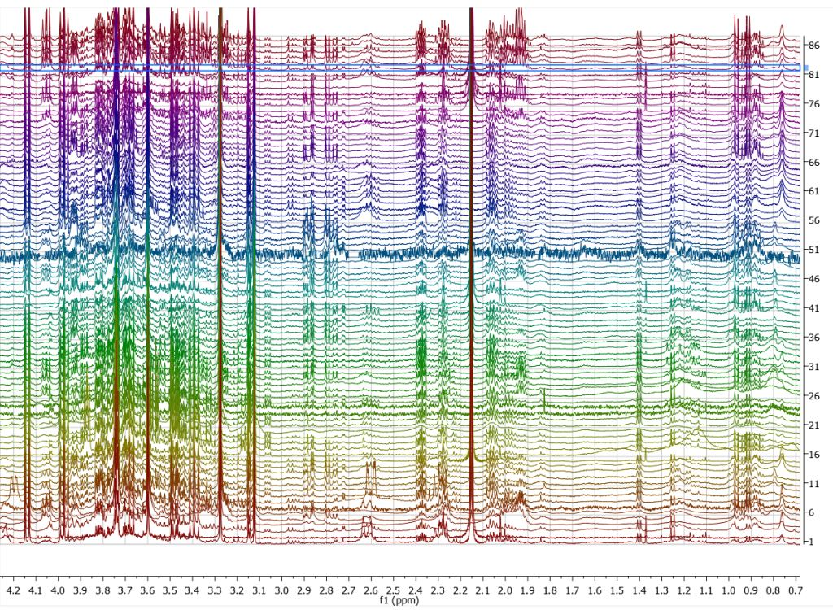
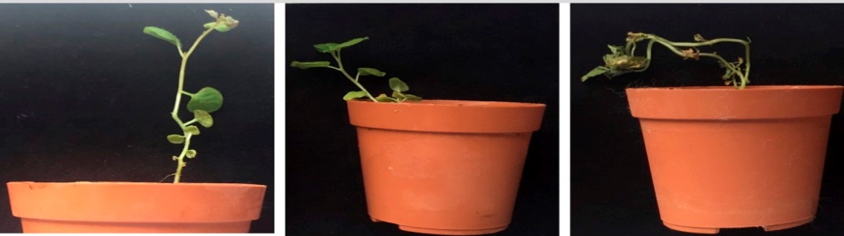
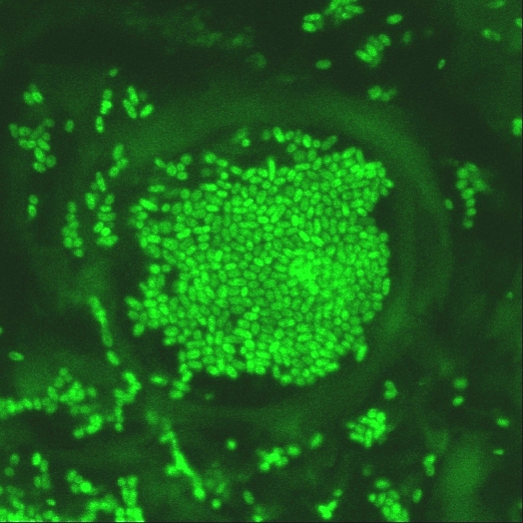
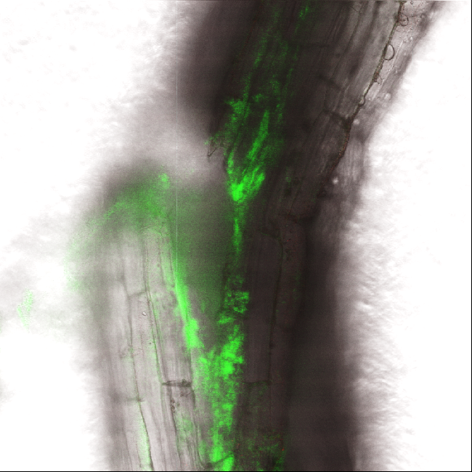


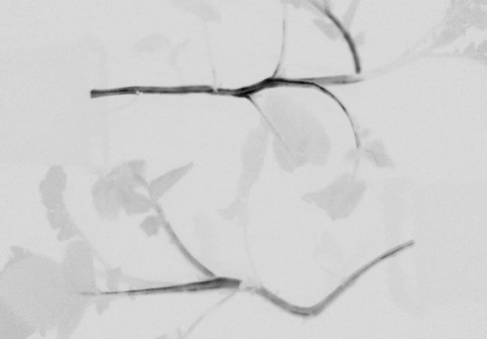
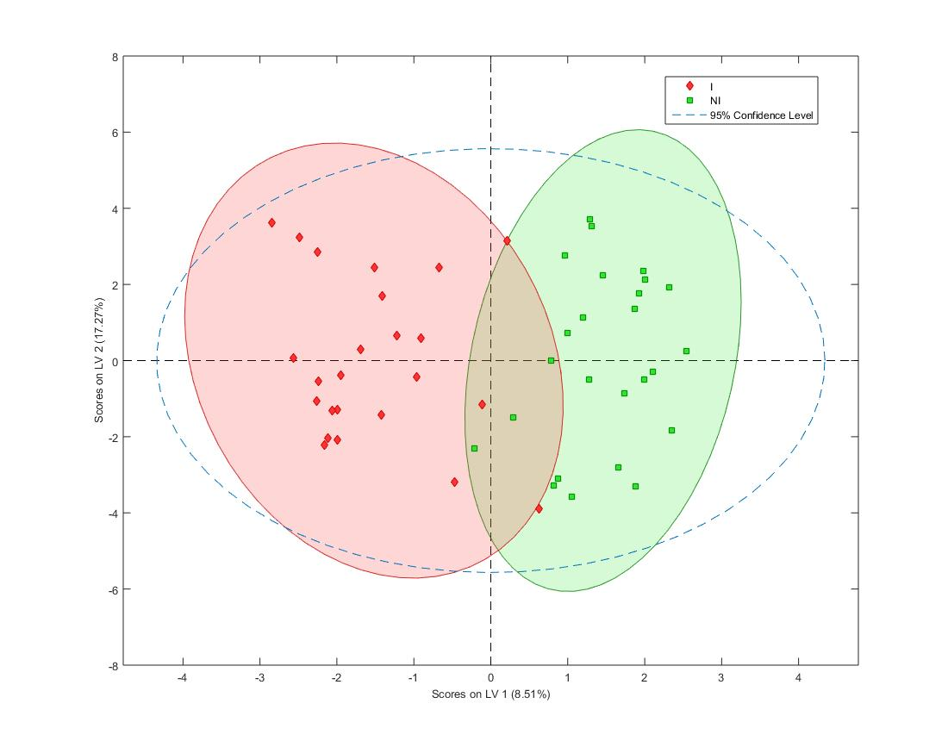
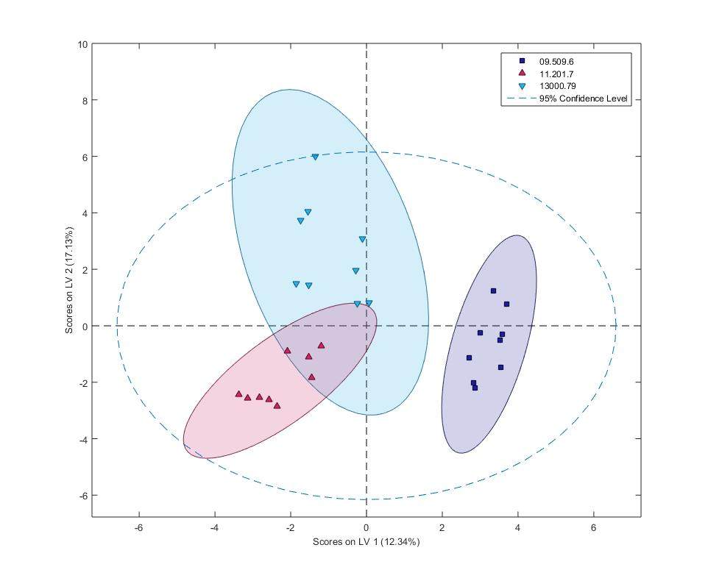
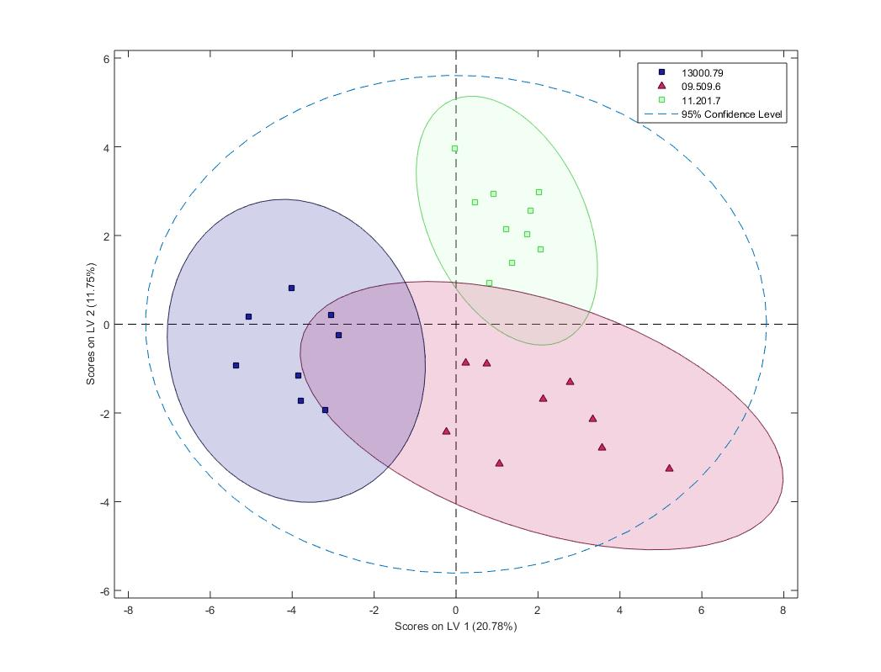

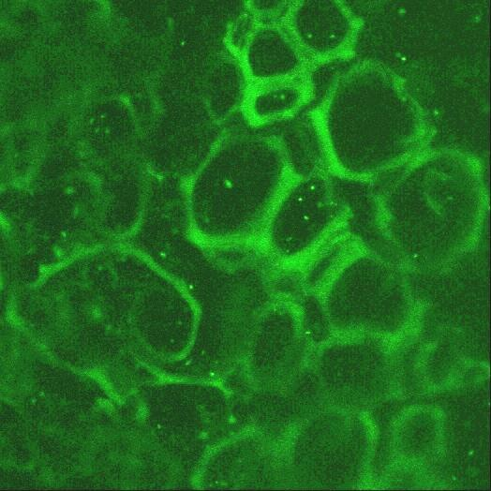

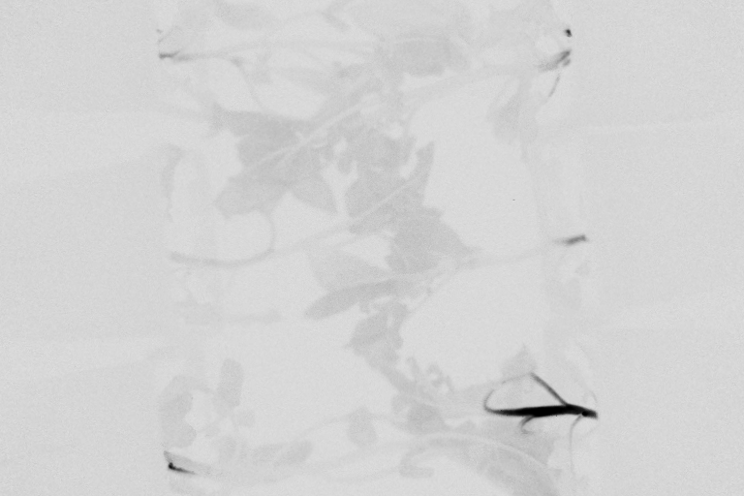
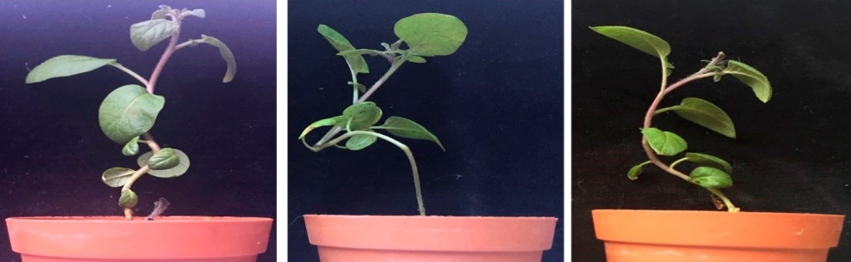







Comparative Ralstonia solanacearum dynamics and metabolic profiling of advanced potato clones with different levels of bacterial wilt resistance
V. Ferreira¹, N. Denis¹, A. Lopez², V. Croce¹, M. Perez¹, F. Vilaró³, G.A. Galvan⁴, M.J. Pianzzola¹, M. Valls⁵, G. Moyna² and M.I. Siri¹
(1) DEPBIO, School of Chemistry, UdelaR, URUGUAY, (2) DQL-CENUR Litoral Norte, UdelaR, URUGUAY, (3) INIA Las Brujas, URUGUAY, (4) Faculty of Agronomy, CRS, UdelaR, URUGUAY, (5) CRAG-UB, Barcelona, SPAIN.
msiri@fq.edu.uy
1 - BACKGROUND
2 – GOALS
Bacterial wilt caused by Ralstonia solanacearum is responsible for substantial losses in cultivated potato crops worldwide.
To evaluate the R. solanacearum colonization, dissemination and multiplication patterns in selected potato genotypes with contrasting levels of bacterial wilt resistance.
Breeding for bacterial wilt resistance is a major challenge for disease control.
A potato breeding program is conducted in Uruguay based on the introgression of resistance from the wild native species Solanum commersonii.
To optimize an ¹H-NMR based metabolomic approach for: i) identification of plant metabolites induced after infection with R. solanacearum, and ii) comparison of metabolite profiles in selected potato genotypes with contrasting levels of bacterial wilt resistance
Several backcrosses were generated exploiting the high genetic variability of this wild species, resulting in advanced interspecific breeding lines with different levels of bacterial wilt resistance.
3 – RESEARCH APPROACH & RESULTS
Pathogen dynamics
Metabolic profiling
R. solanacearum reporter strains UY031 Pps-lux (LuxCDABE) and
UY031 Pps-GFP were used to follow pathogen infection in susceptible and resistant potato genotypes through soil inoculation assays
2 conditions: INOCULATED (10⁷ cfu/g soil, 7 dpi) / NON INOCULATED
3 genotypes: 130001.79 (SUSCEPTIBLE), 11201.27 and 09509.6 (RESISTANT)
Tissue harvest (stem base): 7 dpi
Quenching (liquid N₂)
Aqueous two-phase extraction (MeOH:H₂O:CHCl₃)
Freeze-drying
¹H-NMR (Bruker AVANCE III 500 MHz)
Multivariate analysis (PLS ToolBox –Matlab): PCA, OPLS-DA
> 10⁹ cfu/g
10⁶ cfu/g
SUSCEPTIBLE
SUSCEPTIBLE
Different metabolic profiles among infected and non infected plants
Metabolic profiles of non infected plants reflect the genetic background of each genotype
Metabolic profiles of infected plants were group based on the resistant/susceptible response
0 dpi
3 dpi
7 dpi
5 µm
Stem base
root
25 µm
A
B
C
RESISTANT
RESISTANT
10 µm
<10⁴ cfu/g
10⁶ cfu/g
25 µm
Bioluminescence imaging of UY031 Pps-lux colonization pattern in susceptible (Chieftain) and resistant (11201.27) potato genotypes. Images were acquired 0, 3, and 7 days post inoculation (dpi) using an in vivo imaging system. Black regions indicate tissue areas colonized by light-emitting bacteria.
Representative confocal fluorescence micrographs of stem cross-sections and roots of potato plants soil inoculated with R. solanacearum strain UY031 Pps-GFP. Bacterial colonization was evaluated 7 days after inoculation, in susceptible (13001.79) and resistant (11201.27) potato genotypes. Arrows show bacterial colonization. Bacterial colonization was also evaluated in the same plants by plate counting.
Principal component analysis (PCA) as an unsupervised pattern recognition method, was carried out to examine intrinsic variations in spectra of potato stems aqueous extracts (not shown). Orthogonal projection on latent structure-discriminant (OPLS-DA) as a supervised pattern recognition method was used to obtain maximum information about discriminant compounds in the NMR spectra of extracts from: (A) infected vs. non infected plants, (B) non infected plants of susceptible (13001.79) vs. resistant (11201.27, 09509.6) genotypes, and (C) infected plants of susceptible (13001.79) vs. resistant (11201.27, 09509.6) genotypes. The validations of OPLS-DA models were conducted by random subset test with 20 iterations and 5-10 subsample splits.
4 – CONCLUSIONS & PERSPECTIVES
Acknowledgments & Financial support
Resistant clones showed colonization only in roots and the stem base, suggesting that resistance in potato is achieved through restriction of bacterial invasion and multiplication in stems.
R. solanacearum multiplied in a limited number of xylem vessels and reached lower population densities in stems of resistant plants.
The NMR based metabolomic approach was able to differentiate the metabolic profiles of infected vs. non infected plants, and susceptible vs. resistant inoculated plants.
Identification of relevant metabolites induced after infection with R. solanacearum, and metabolites responsible for bacterial wilt resistance in advanced potato clones is currently under progress.
Grant CSIC I+D 1514 (M.I. Siri)
Programme for the Development of Basic Science (PEDECIBA)

